Slide 1
Fundamental Programming in JAVA
Array Of Objects

Slide 2
Objectives
To Implement a type that uses an array instance variable.
To describe how to create arrays of objects.
To store and process objects in arrays.
To program common array of objects operations (displaying arrays, summing all elements and finding the minimum and maximum).

Slide 3
Array Of Objects
An array is a collection of the same data type that dynamically creates objects and can have elements of primitive types.
Java is an object-oriented programming language, and most of the work is done with the help of objects.

Slide 4
Array Of Objects
Java allows us to store objects in an array.
If you want to store a single object in your program, then you can do so with the help of a variable of type object. But when you are dealing with numerous objects, it is advisable to use an array of objects.

Slide 5
Array Of Objects
An array of objects is an array of references to objects
The boxes variable holds the address (reference) of a Rectangle array.
Rectangle[] boxes = new Rectangle[5];
boxes
reference
boxes[0]
null
The array is an array of references to Rectangle objects.
boxes[1]
null
boxes[2]
null
boxes[3]
null
boxes[4]
null
5

Slide 6
Instantiating Arrays of Objects
Each element needs to be initialized.
for (int i = 0; i < boxes.length; i++)
boxes[i] = new Rectangle();

Slide 7
Instantiating Arrays of Objects
Rectangle objects.
length , width
The boxes variable holds the address (reference)
of an Rectangle array.
0.0
0.0
length , width
boxes
reference
0.0
0.0
boxes[0]
reference
length , width
0.0
0.0
boxes[1]
reference
length , width
0.0
0.0
boxes[2]
reference
boxes[3]
reference
length , width
0.0
0.0
boxes[4]
reference

Slide 8
Invoking a method in array of objects
An array of objects is actually an array of reference variables.
So invoking boxes[3].setLength(8.3) involves two levels of referencing as shown in the next figure.
boxes[3].setLength(8.3)
boxes references to the entire array.
boxes[3] references to a Rectangle object.

Slide 9
Invoking a method in array of objects(cont)
boxes[3].setLength(8.3); boxes[3].setWidth(4.1);
Rectangle objects.
The boxes variable holds the address (reference)
of an Rectangle array.
length , width
0.0
0.0
length , width
boxes
reference
0.0
0.0
boxes[0]
reference
length , width
0.0
0.0
boxes[1]
reference
length , width
8.3
4.1
boxes[2]
reference
boxes[3]
reference
length , width
0.0
0.0
boxes[4]
reference

Slide 10
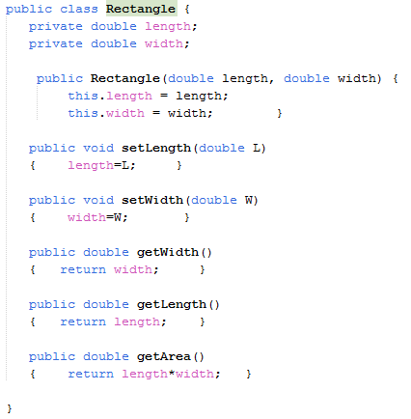
Array Of Objects - Example

Slide 11
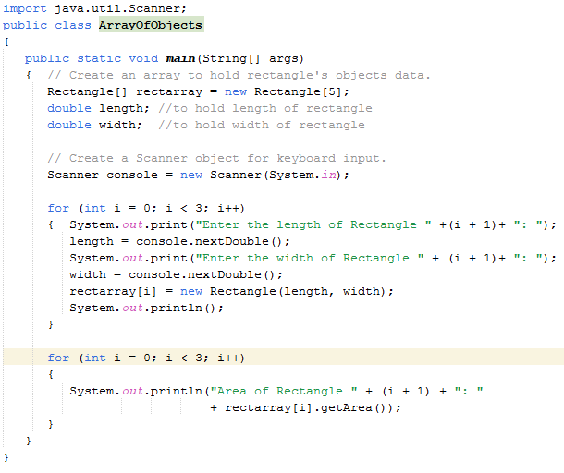
Array Of Objects – Example Cont.

Slide 12
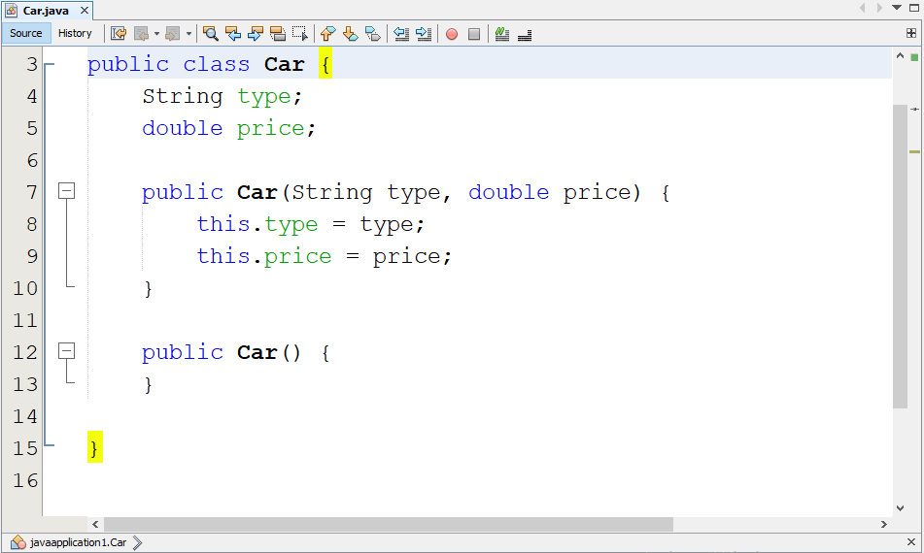
Array Of Objects - Example
initializing each member of the array when creating it.
Car[] cars = new Car[]{
new Car("Toyota", 2022),
new Car("BMW", 2018),
new Car()};

Slide 13
Array Of Objects - Example
The cars variable holds the address (reference)
of a Car array.
Car objects.
Toyota
make year
2022
cars
reference
cars[0]
reference
2018
make year
BMW
cars[1]
reference
cars[2]
reference
make year
null
0

Slide 14
An Array Instance Variable
As you continue your study of computing fundamentals, you will spend a fair amount of time using arrays and managing collections of data. The Java array is one of several data storage structures used inside classes with the main task of storing a collection. These are known as collection classes with some of the following characteristics:
The main responsibility of a collection class is to store a collection of objects
Objects are added and removed from a collection
A collection class allows clients to access the individual elements
A collection class may have search-and-sort operations for locating a particular item.
Some collections allow duplicate elements; other collections do not

Slide 15
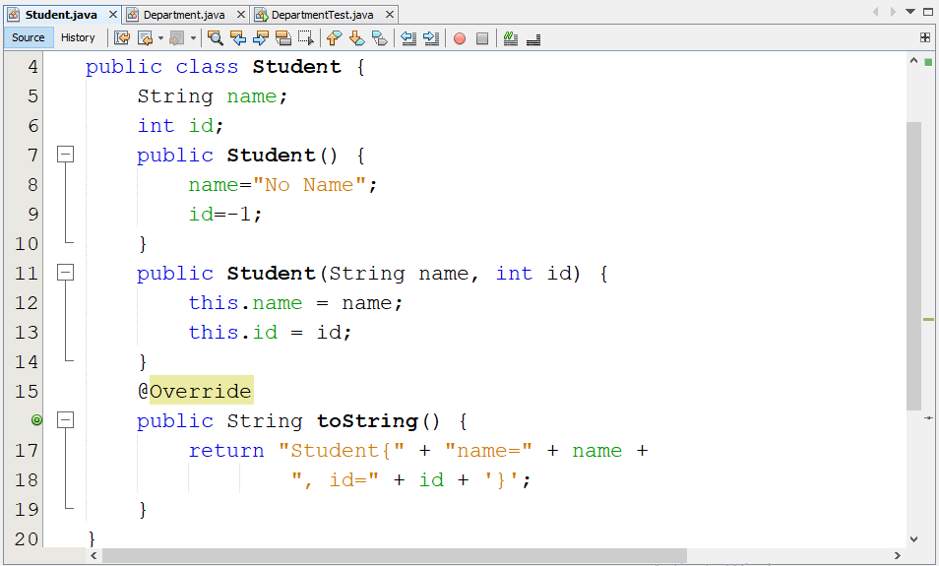
An Array Instance Variable-Example

Slide 16
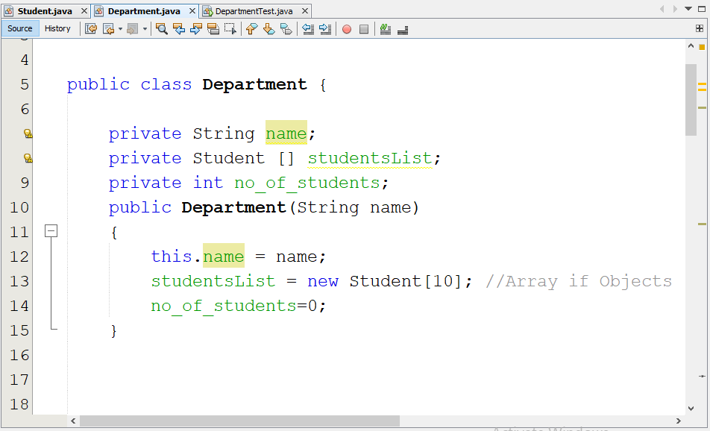
An Array Instance Variable-Example
Data Fields
Constructor

Slide 17
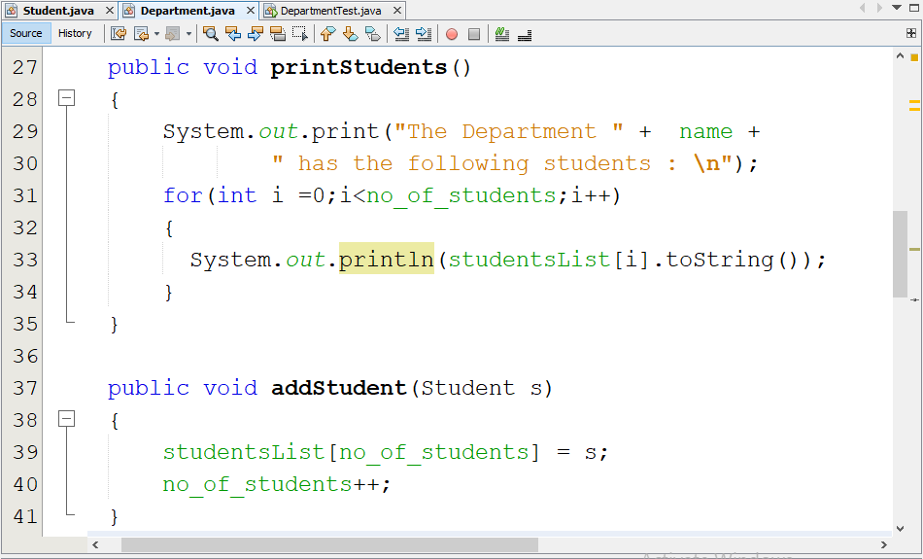
An Array Instance Variable-Example
This method prints the data of all students in the Department
This is how to add a new student (Object) to the department

Slide 18
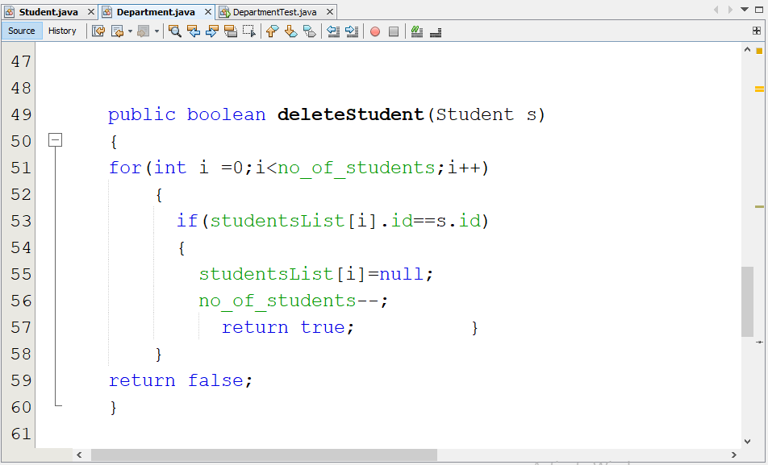
An Array Instance Variable-Example
This is how to delete a student (Object) form the department

Slide 19
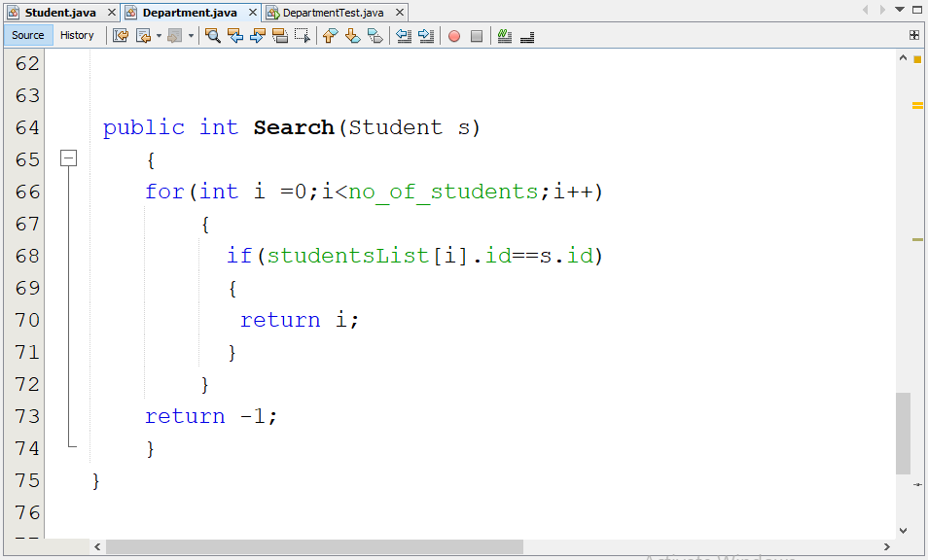
An Array Instance Variable-Example
This method searches for a specific student(Object), returns his position in the array, or returns -1 if it does not exist

Slide 20
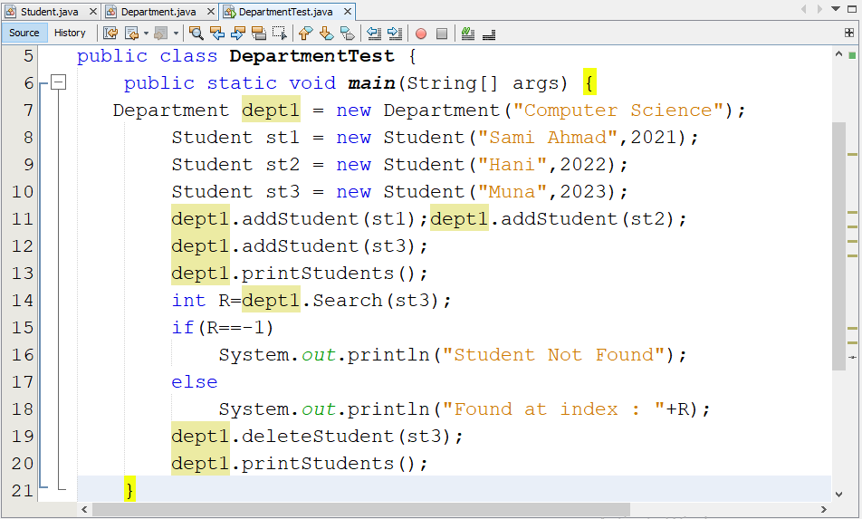
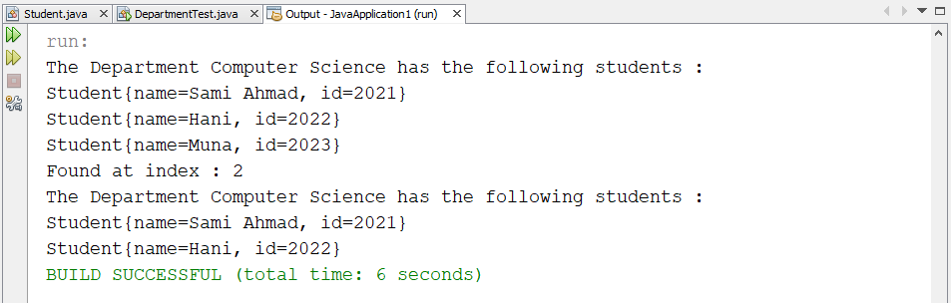
An Array Instance Variable-Example

Slide 21
References
Introduction to Java Programming, Comprehensive Version, Student Value Edition, Daniel Liang, 12th Edition, Pearson 2019
lecture Notes: edugate.asu.edu.jo.
lecture Videos: YouTube channel.
How to install JDK & NetBeans IDE manual.

